Slide 1


KARNAVATI UNIVERSITY
Unitedworld Institute of Technology
ONLINE VOTING SYSTEM
Professional Training
Semester: 4th
Programme: B. Sc. (Hon’s)
Guided by:
Ms. Rama M. Maliya and Mr. Sanjay Ajani
Assistant Professor
UIT, KU
Prepared by:
VIKEN PATEL - 20220701033

Slide 2




FRONT END
TECHNOLOGY
CSS
HTML
BACKEND
TECHNOLOGY
VS Code
JAVA

Slide 3

PROJECT
Functionalities
Voting System Interface
Input of Voter
Name
Age
Number
After Input, Results can be seen
History

Slide 4
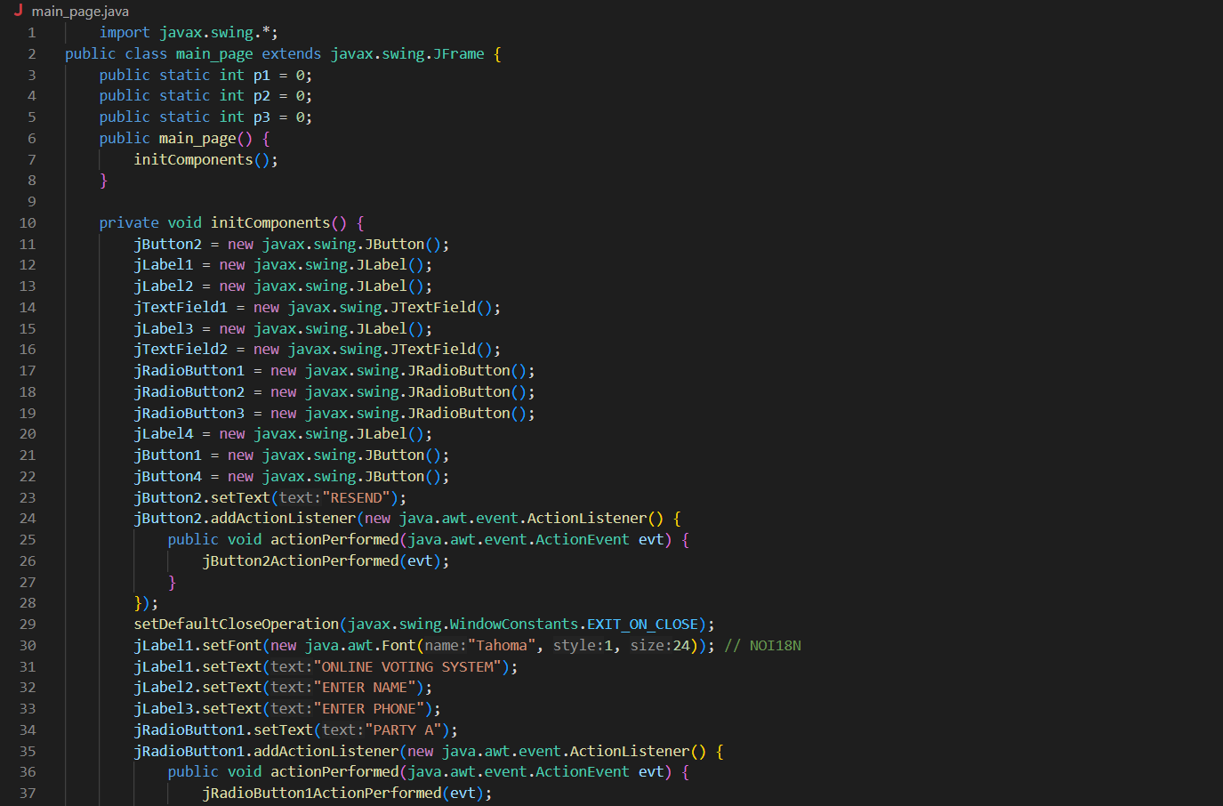
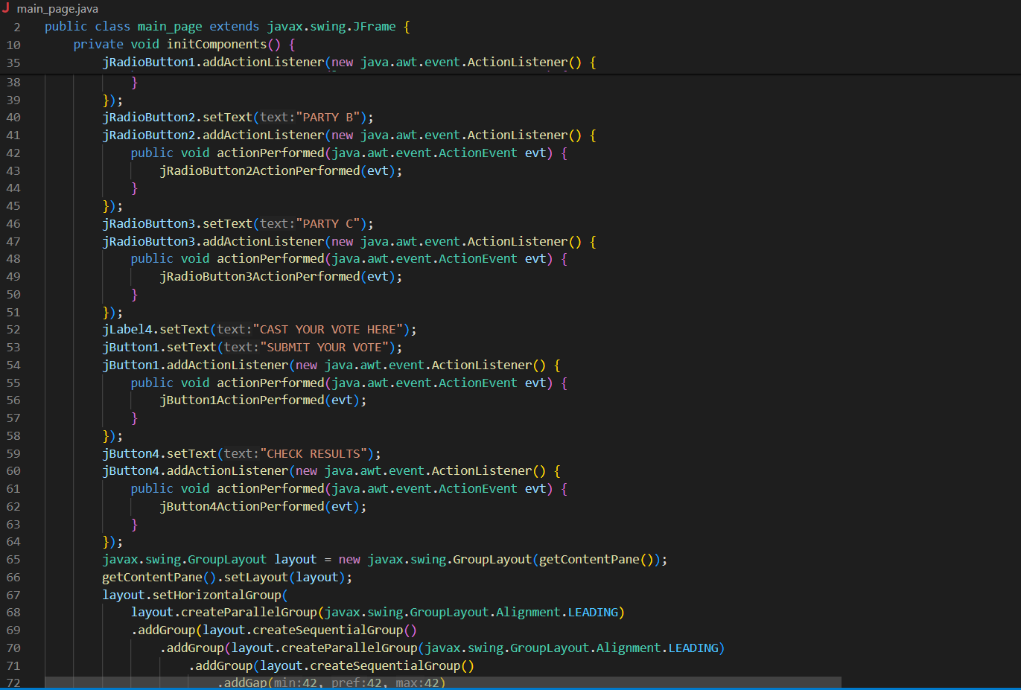
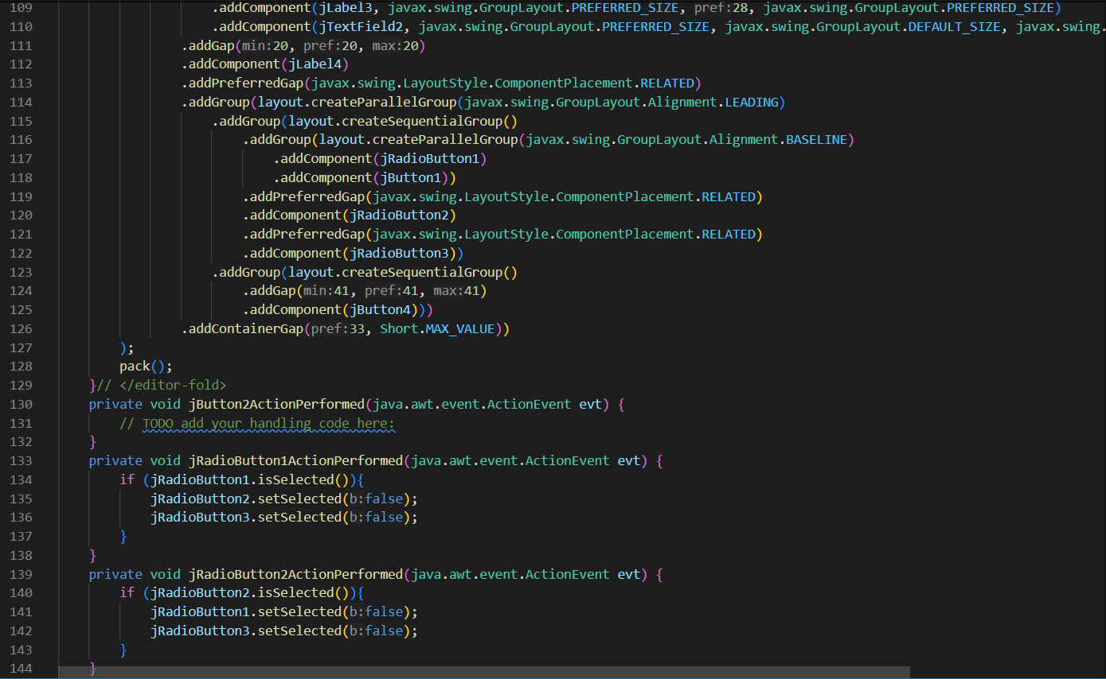
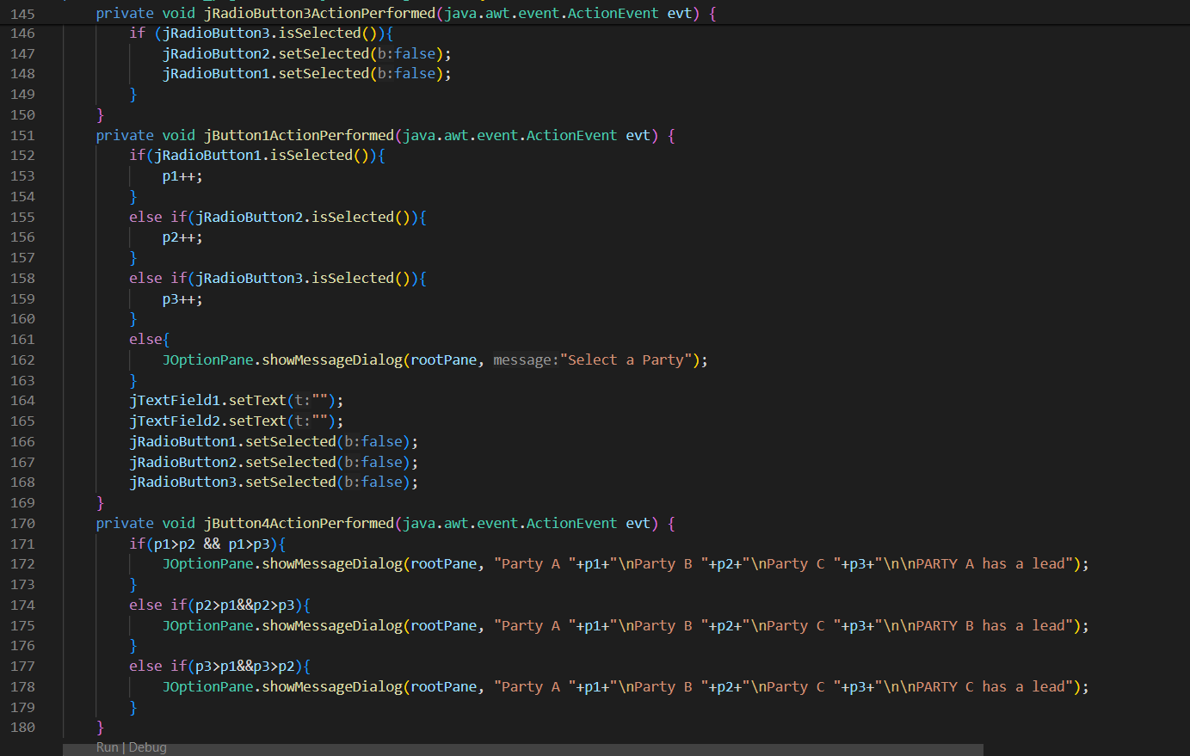
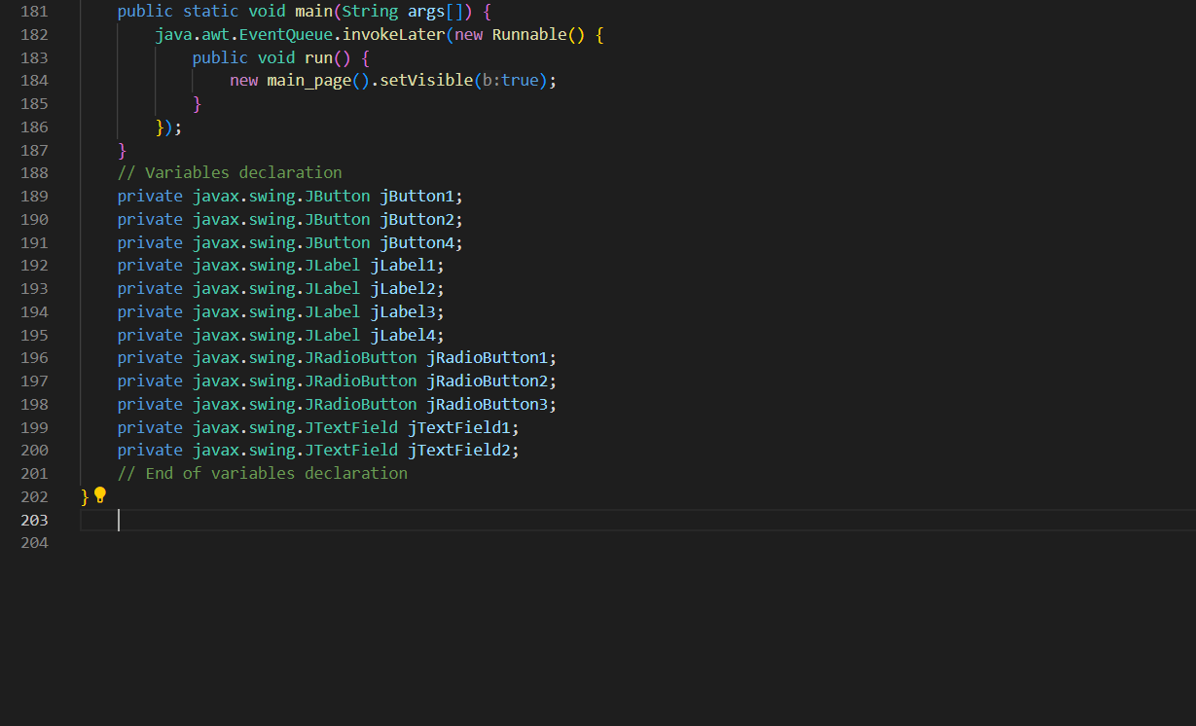
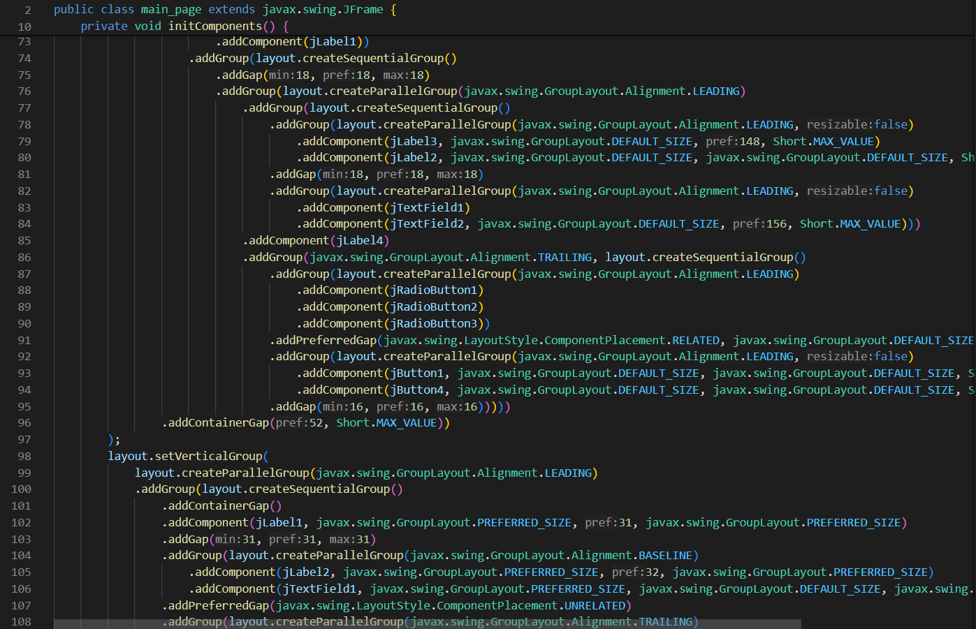
PROJECT
Screenshots

Slide 5
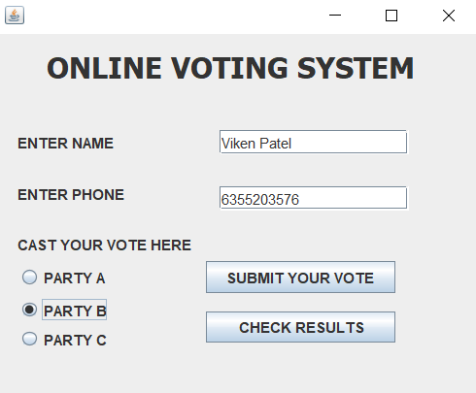
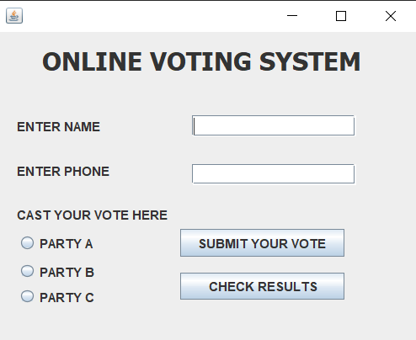
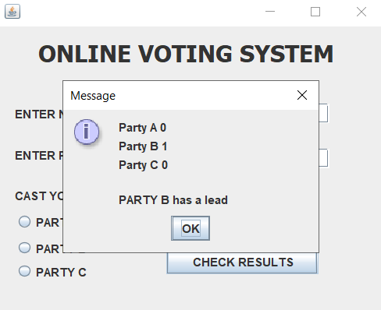
PROJECT
Screenshots

Slide 6
PROJECT LINK
Drive Link : https://drive.google.com/file/d/1N9YS8l89aJFLqe5xmK0jzAuF6QT6NauA/view?usp=drive_link

Slide 7
THANK YOU

